Slide 1
Biol 7200: Programming for Bioinformatics Week 11 assignment demos and broken code

Slide 2
Plan for today
Code demos
Broken code
If there’s time, review material

Slide 3
Broken code structure reminder
What’s it trying to do?
What’s wrong with it?
How would you fix it?

Slide 4
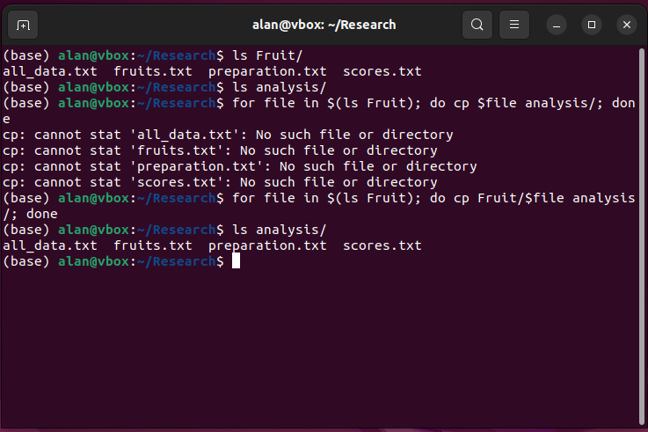
Broken code 1
What’s it trying to do?
What’s wrong with it?
How would you fix it?

Slide 5
Broken code 1
What’s it trying to do?
Copy some files to another directory
What’s wrong with it?
ls doesn’t include the provided path in output paths unless input is a glob
How would you fix it?
Add the directory to the source file (Fruit/$file) or give ls a glob like ls Fruit/*

Slide 6
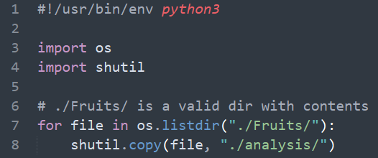
Broken code 2
What’s it trying to do?
What’s wrong with it?
How would you fix it?

Slide 7
Broken code 2
What’s it trying to do?
List a directory’s contents and copy them to another directory
What’s wrong with it?
Os.listdir doesn’t include the provided path in output paths unless input is a glob
How would you fix it?
Add the directory to the source file (f”./Fruit/{file}”)

Slide 8
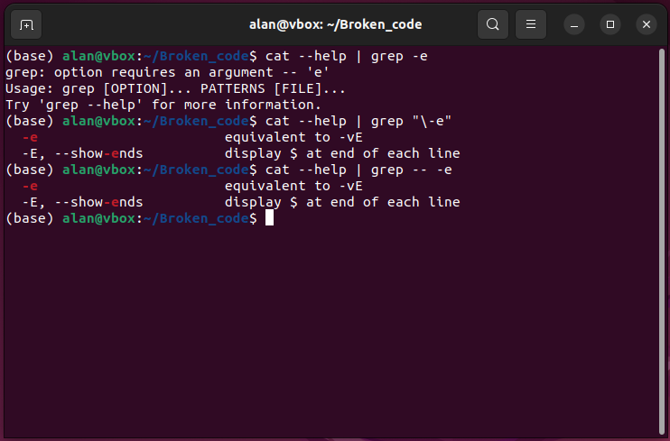
Broken code 3
What’s it trying to do?
What’s wrong with it?
How would you fix it?

Slide 9
Broken code 3
What is it trying to do?
grep a help message for the “-e” option
Why doesn’t it work?
grep interprets the “-e” as an option not a pattern
How can we fix it?
Escape the “-” with a “\” or use “--” to indicate no more options

Slide 10
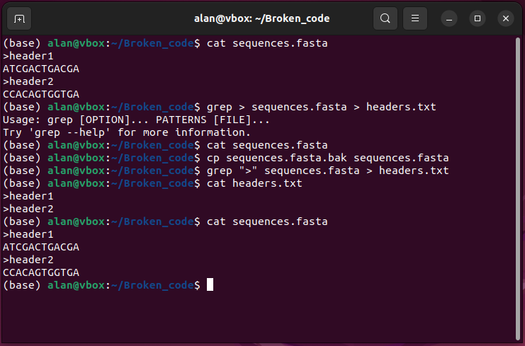
Broken code 4
What’s it trying to do?
What’s wrong with it?
How would you fix it?

Slide 11
Broken code 4
What is it trying to do?
Extract headers from a fasta file by searching for lines containing “>”
Why doesn’t it work?
Your shell interprets the “>” as a stdout redirect
grep is run without a pattern, which is required input, so sends and error to stderr and nothing to stdout
The empty stdout from grep is directed to sequences.fasta, overwriting it
How can we fix it?
Protect the “>” from interpretation by your shell using quotes

Slide 12
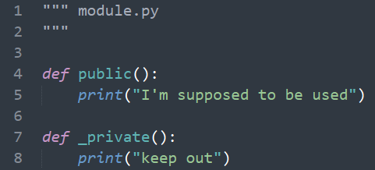
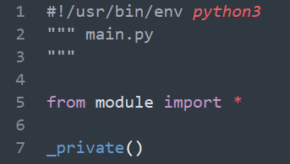
Broken code 5
What’s it trying to do?
What’s wrong with it?
How would you fix it?

Slide 13
Broken code 5
What’s it trying to do?
Define a module with a public function and a private function
Import everything from a module into a script’s namespace
What’s wrong with it?
Bad practice to from X import * as it might replace other things in your namespace
From X import * doesn’t import anything with leading underscores
How would you fix it?
Don’t use from X import *
Don’t make functions private if you intend to use them
Define an __all__ variable in module specifying what should be imported with *
N.B., __all__ is read by some IDEs (like VS Code) to control autocompletion.

Slide 14
End of Lesson

